Slide 1



Everyday Adulting 101
By: Payal and Jocelyn

Slide 2

1) Interviews
Basic Skills
2) Email Etiquette
3) Networking
4) Resume

Slide 3


Interview Skills
Dress appropriately
Be yourself (do not make yourself up)
Look people in the eye when you talk (eye contact 2-5 seconds)
Do not use your hands to talk
Mock interviews with yourself so you are prepared
Shake hands with every interviewer
Show interest by asking questions
At the end, thank them for the opportunity
Bring water with you
Smile (facial expressions)
Answer with detail and share examples

Slide 4
Interview Partner
FIND SOMEONE IN A DIFFERENT GRADE TO WORK WITH

Slide 5

Interview Question 1
What are your strengths and weaknesses?

Slide 6
Interview Question 2
Who is someone you look up to?

Slide 7
Interview Question 3
Name a time you have faced adversity and how you overcame it?

Slide 8

Email Etiquette
Tone
Do not email a teacher complaining about grades; instead schedule an appointment with them to discuss areas of improvement.
Think about the impression your tone will leave: if you are angry, wait 24 hours
Do not write in all capitals
Content
Always reread your emails to check for mistakes
If your email gets too long, consider meeting with the person face-to-face
Reference your attachments and double-check them (send them as a pdf)
Format
Be mindful of different formats: fonts, images, and characters. They may appear different on their end.
Use proper structure and layout
Do not write long emails and watch out for run-on sentences. Emails should be concise.
Leave out the abbreviations (no texting format)
Other tips
Wait at least 24 hours to send a follow-up if they have not responded.

Slide 9
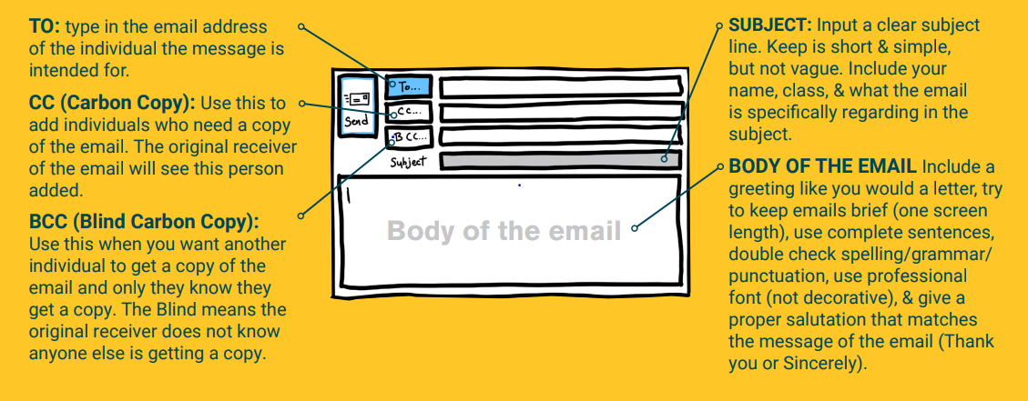
Understanding Parts of an Email:

Slide 10
Good Afternoon Mr. ***,
I was wondering if you could go over the questions I missed because I wasn’t expecting to do so bad. I have been struggling with your tests this semester which is making me nervous for next year, what are some things that I could do to get better?
Thank you so much,
Payal Patel
Good Afternoon,
I need help… I haven’t been doing good on your multiple choice exams (I got an A but that was with extra credit…
Thank you,
Payal Patel
Dear Mr. ***,
I received an 85 on my story essay, and I want to know how I can improve as a writer, so I can get better scores going forward. When can I come into tutoring to go over, what caused me to get three 4’s, and what I could I have done to work towards getting all 5’s?
Thank you so much,
Payal Patel

Slide 11
Good Afternoon Mr. ***,
Thank you so much for this opportunity and I had so much fun today and getting to know everyone! I am sending this email to let you know that I have received your email about tomorrow’s interview! Again, I appreciate your time and consideration.
Sincerely,
Payal Patel

Slide 12
Scenario: You were not present in class and need to know what you missed and if you need to make up anything.
Hey Queen,
What should I do?
Toodles,
Boby Jo
To Mrs Reid,
Can you do your job and tell me what I need to do?
Billy Bob
Good Morning Mrs. Reid,
I was not here in class today. Is there anything that I need to make up and are there any study materials I can use to catch up? Thank you so much for all that you do for us!
Sincerely,
Robby James

Slide 13

Networking
Networking is an important skill for any time you are interacting with a large group of people
It is a great way to make connections with people to develop stronger relationships later
Find something you have in common and elaborate

Slide 14
Networking Activity
Go up to someone you do not know and talk to them for 3 minutes straight

Slide 15
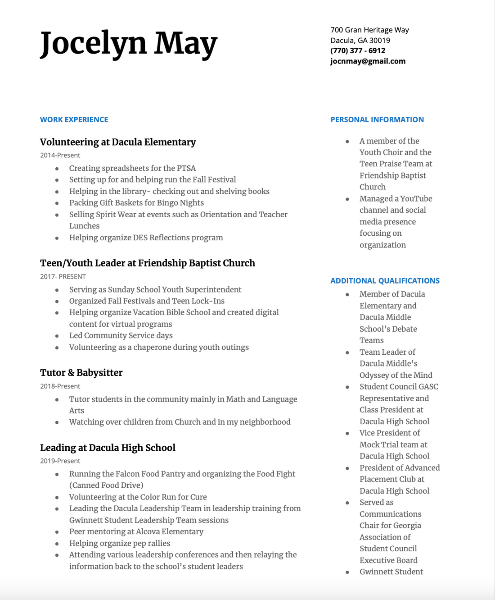

Professional Resumes
It is very important to have a resume because you never know when you will need one
Leadership Positions
Jobs
College Applications
Scholarship Applications

Slide 16
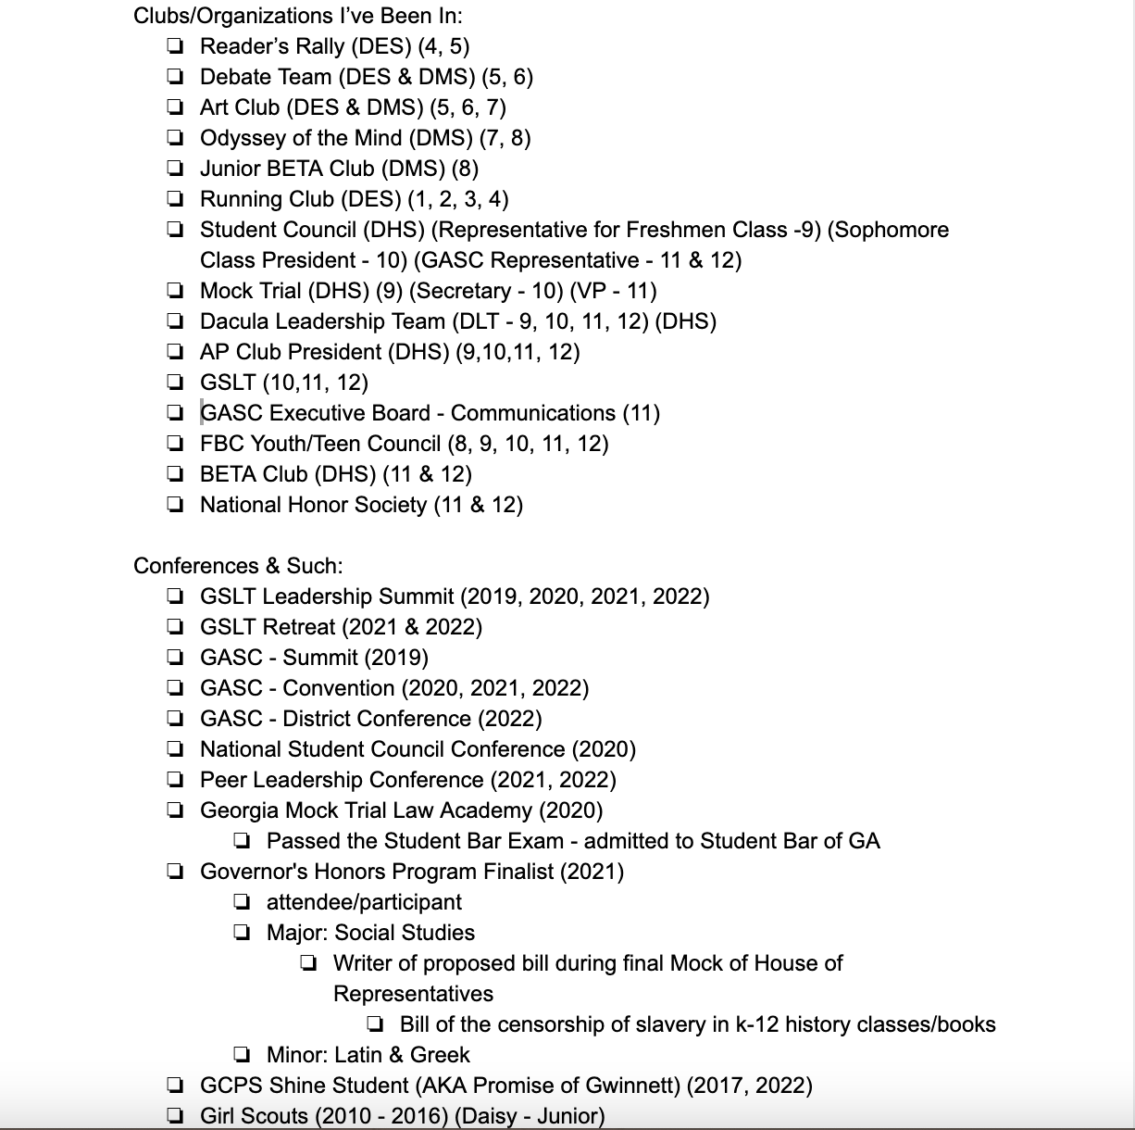
Involvement List
Keep track of your accomplishments throughout high school for later reference
Clubs
Leadership Positions
Conferences
ex.

